Slide 1
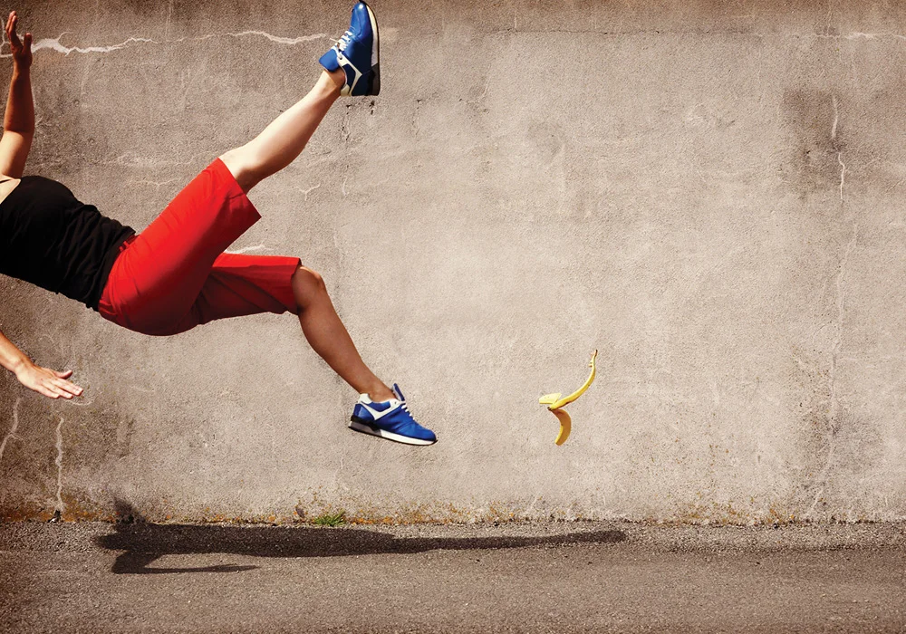
Serious fail: How a fail led to a Title IX talk
(Image Source/Corbis)

Slide 2
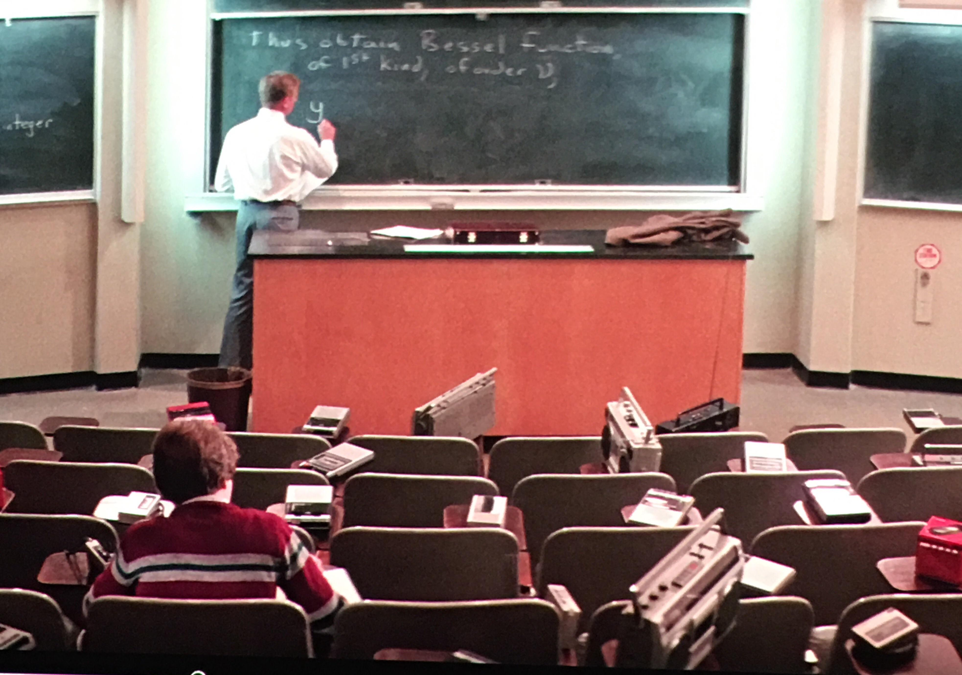
It began like any other instruction session…..
Kinesiology 200
Lecture Hall
Approximately 170 students
Active learning exercise
Padlet
Image Source: “Real Genius”

Slide 3
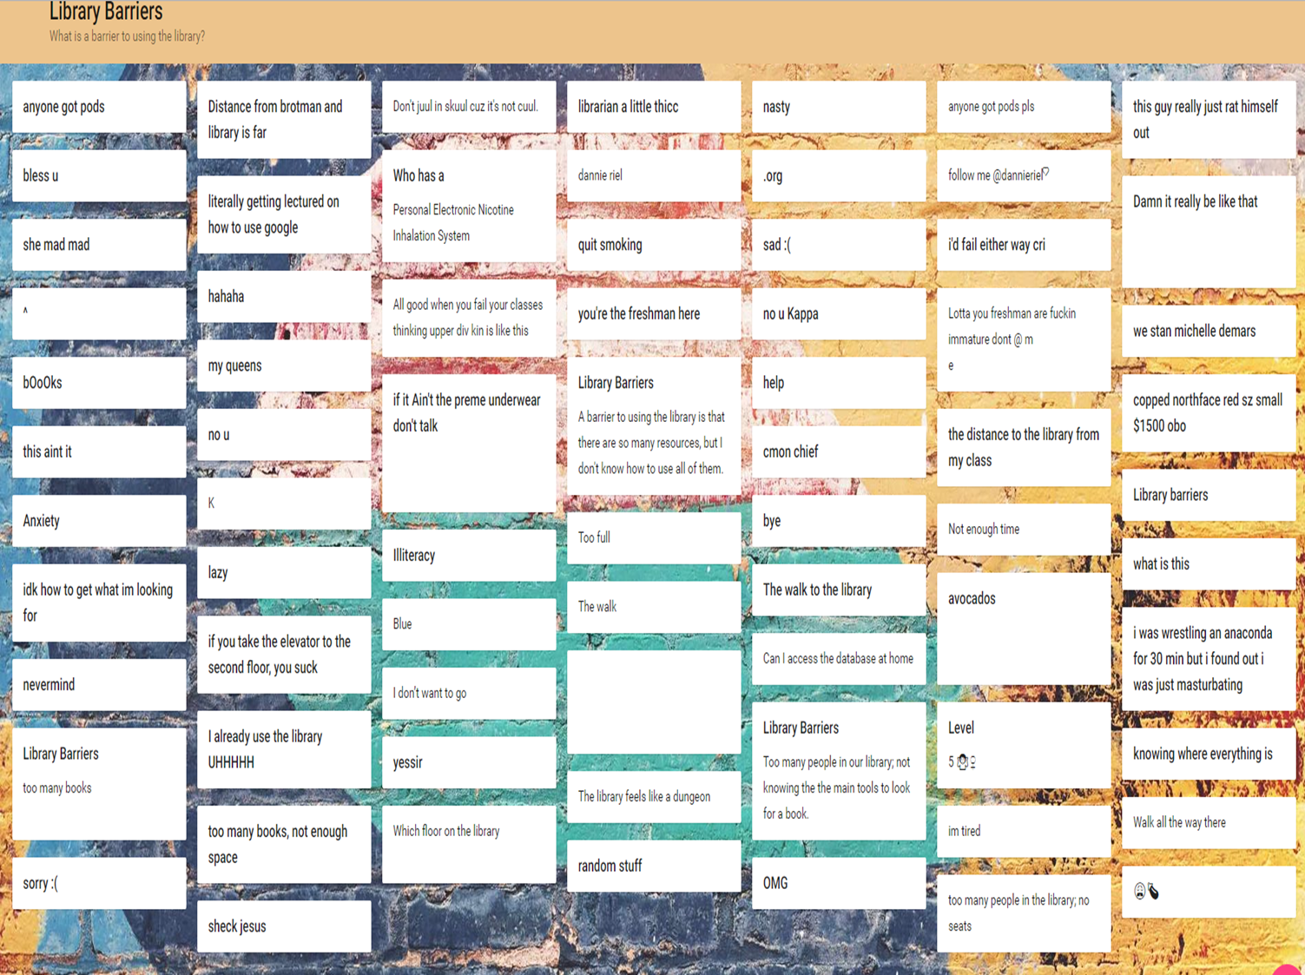
72 responses

Slide 4
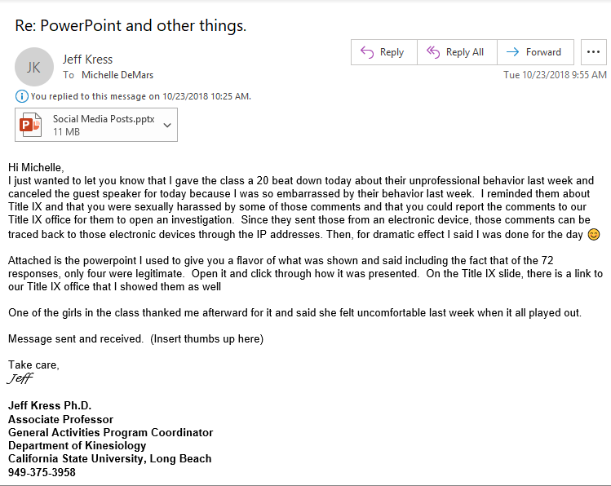
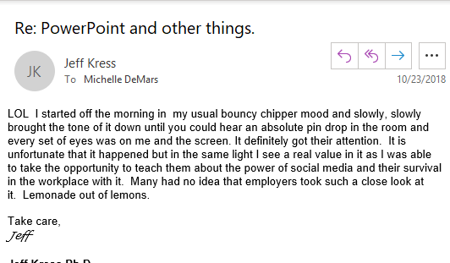

Slide 5
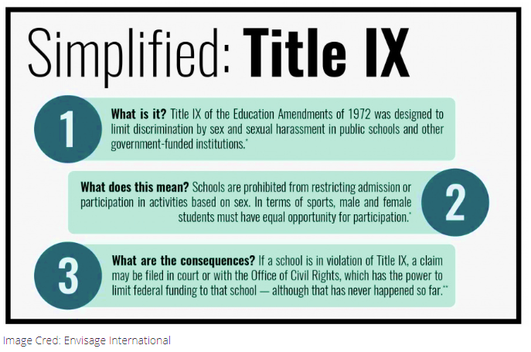
Image cred: Society of Women Engineers

Slide 6
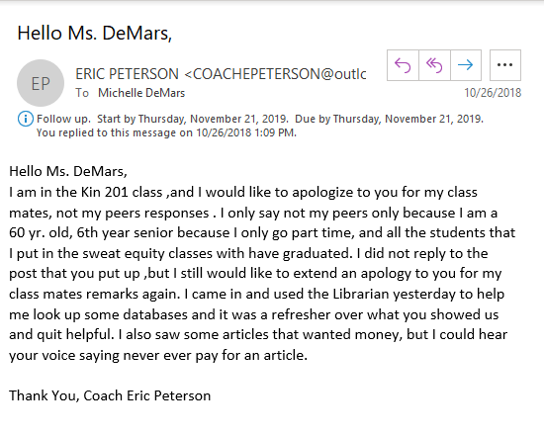
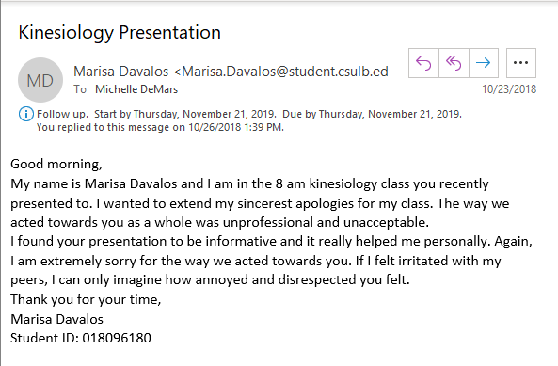
Student responses
I received both e-mail and in person apologies for the behavior of the class.
One young woman verbally told me how disturbed she was by the class.

Slide 7
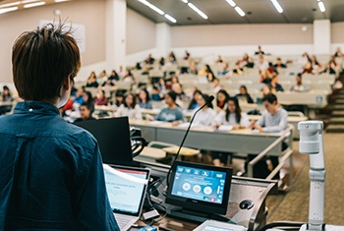
It ended unlike any other instruction session…..
Better prepared for future instruction sessions, especially large class sizes
Use Padlet editing features
Faculty includes Title IX talk every semester because of our class

