Slide 1
Remix the worksheet: Creative ideas for analog instruction
Carolyn Caffrey Gardner
SCILWorks 2020

Slide 2
Why analog?
Resist the database demo
Slooooooooow computers
Informed by tenets of andragogy
Problem-centered and allows for self-direction
May reduce anxiety related to perceived technology abilities (Cooke, 2010)
Notes:
“Before we get started please make your way to the CSUDH library homepage, a quick way to get there is….” or url….” Sets the tone and expectation for database demonstration and usually for searching of some kind…..
Also having computer issues
Andragogy - pedagogy for adult learners, a lot of it is best practices we know for all learners. Recommends for adults that teaching be problem rather than content orientated. Learners are motivated by self-direction. Adult learners may have some fixed ideas about their abilities (Malcom Knowles the original theorist wrote a lot about andragogy to help with computer skills and Nicole Cook notes that tech ability can be a more fixed barrier for adults too). How many of you have had someone come in and say ohhhh I’m not a compute rperson?

Slide 3
Analog Activities
Whiteboard Walks
Conceptual Maps
Source Analysis
Notes:
“Before we get started please make your way to the CSUDH library homepage, a quick way to get there is….” or url….” Sets the tone and expectation for database demonstration and usually for searching of some kind…..
Also having computer issues
Andragogy - pedagogy for adult learners, a lot of it is best practices we know for all learners. Recommends for adults that teaching be problem rather than content orientated. Learners are motivated by self-direction. Adult learners may have some fixed ideas about their abilities (Malcom Knowles the original theorist wrote a lot about andragogy to help with computer skills and Nicole Cook notes that tech ability can be a more fixed barrier for adults too). How many of you have had someone come in and say ohhhh I’m not a compute rperson?

Slide 4
Whiteboard Walk
Supplies needed: Big pieces of paper or whiteboards, markers, prompts
Time: Anywhere from 10-30 minutes depending on your prompts
Why: Place prompts in different areas, have groups rotate and respond to each prompt and any existing student answers, discuss

Slide 5
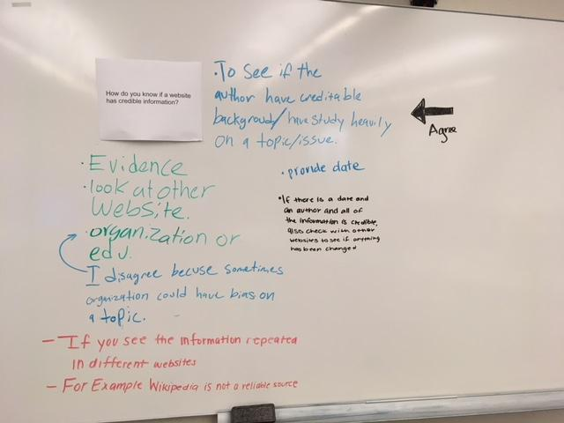
Notes:
This was part of a series on source evaluation for freshmen. The other questions in this group were “Who writes scholarly journals and who are they written for?” “How can you tell if something is scholarly?” ….. For a research as inquiry set “What was the last thing you researched” “You just got a research assignment, what is the first thing you do?” . Tip: Open ended questions

Slide 6
What whiteboard walk question ideas do you have?

Slide 7
Conceptual Mapping
Supplies needed: Paper maps or items to sort, stickers (optional), items to map
Time: Anywhere from 10-30 minutes depending on your map
Why: Great for removing binaries from conversations about sources (Seeber, 2018), opening up discussion or as a review, works well for categorizing

Slide 8
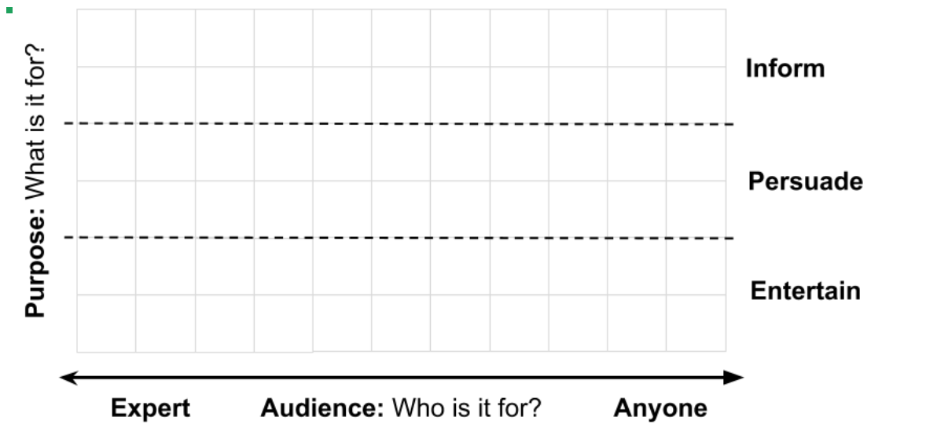
Notes:
Tip: Make sure it works. Have other people test it. Take the novice mindset

Slide 9
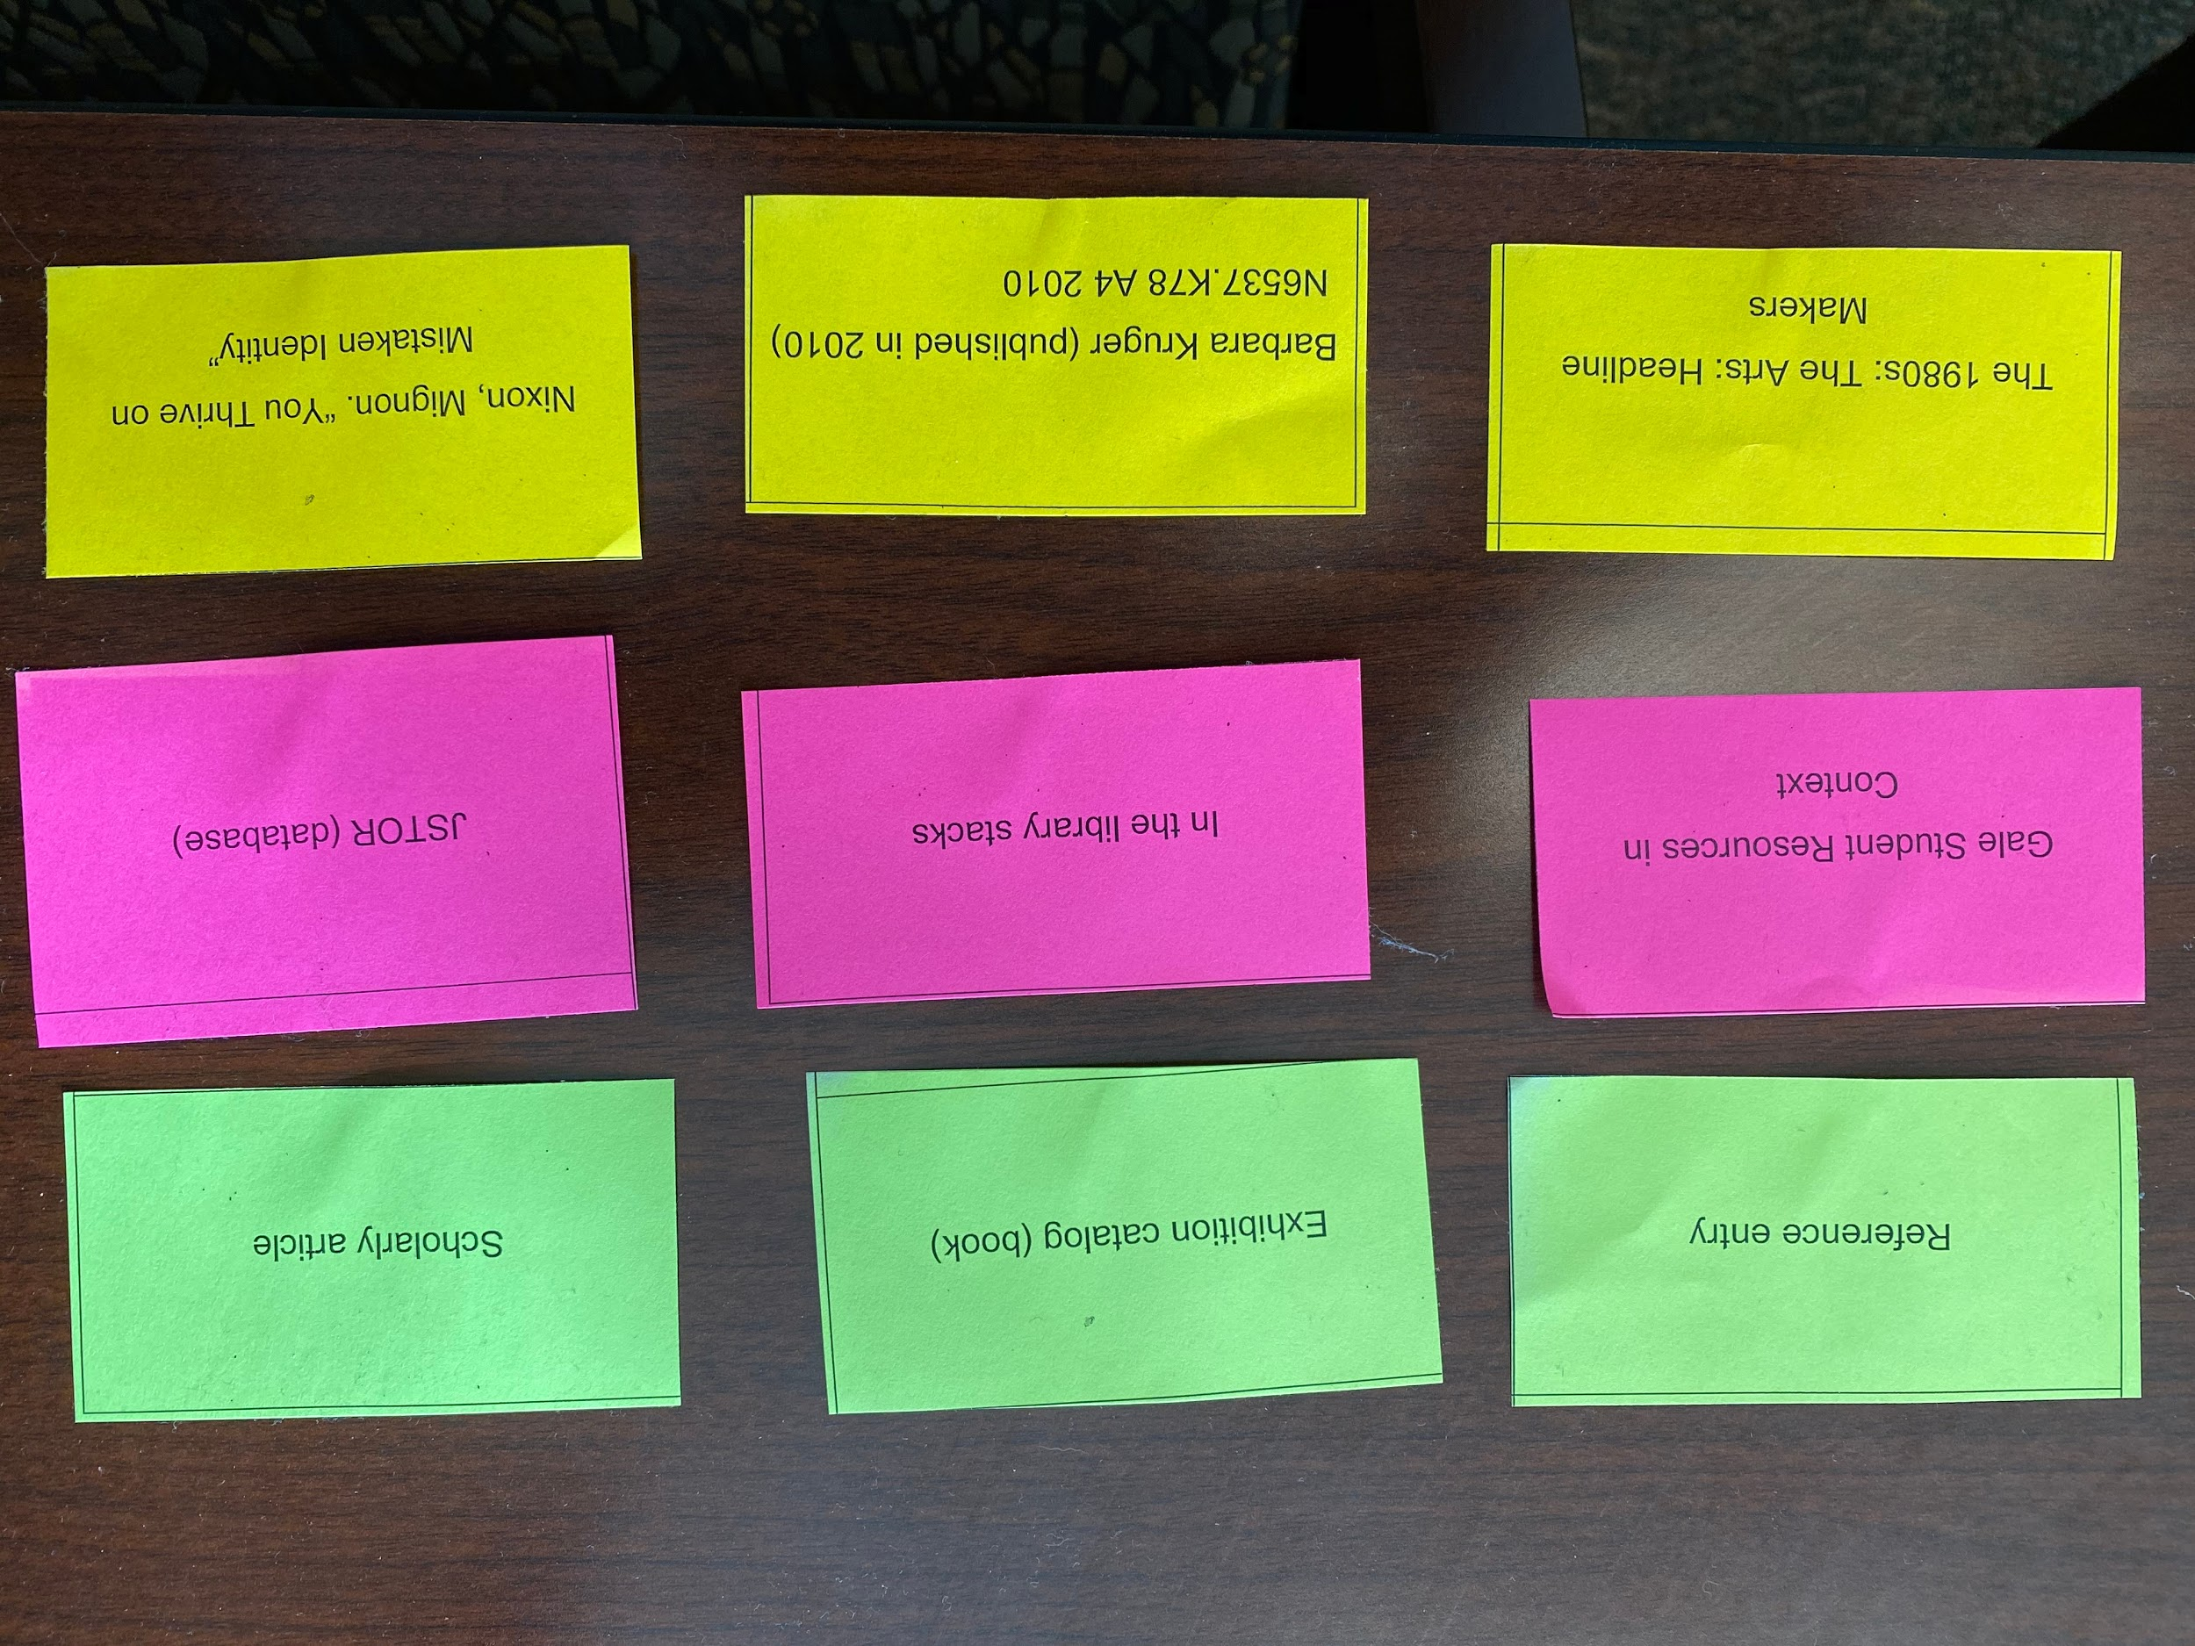
Notes:
My colleague Dana Ospina for an introductory art class where students needed to use a variety of search tools. A different kind of map - still using that conceptual part of the brain to sort type of source / where to find it / example title

Slide 10
Source Analysis
Supplies needed: Physical sources to analyze, post-its, highlighters
Time: Anywhere from 20-45 minutes depending on your sources and questions
Why: Deeper analysis of genre conventions, scholarship as a convo, or evaluation
Notes:
Tip: more resource intensive, more dependent on the timing of when the session is

Slide 11
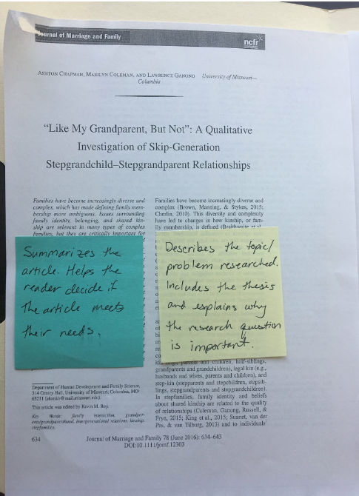
Circle - What is the title of the journal?
Underline - What are some keywords related to what the article is about?
Highlight - All of the in-text citations
Highlight - Any “direct quotations” in the text of the article?
What part of the article has the most in-text citations? Why do you think that is?
Is there any section of the article without in-text citations?
Create an APA citation for this article (this will be easiest typed). Check out libguides.csudh.edu/citation/apa

Slide 12
Questions?
Carolyn Caffrey Gardner
CSU Dominguez Hills Library
Information Literacy Coordinator
cgardner@csudh.edu
@ccaffgardner
Notes:
Of course you could use Google forms, etc.

Slide 13
References & Acknowledgements
Cooke, N. A. (2010). Becoming an andragogical librarian: Using library instruction as a tool to combat library anxiety and empower adult learners. New Review of Academic Librarianship, 16(2), 208-227.
Seeber, K. "Teaching CRAAP to robots: Artificial intelligence, false binaries, and implications for information literacy." Presentation at the Critical Librarianship and Pedagogy Symposium, Tucson, AZ, November 15-16, 2018.
Many thanks to my colleagues Dana Opsina, Tessa Withorn, and Maggie Clarke who have adapted and graciously allowed me to use their adaptations as examples.
You can find the audience/purpose activity in Project CORA

Slide 14
Image Credits
“Turntable free icon” by Smashicons at flaticon.com
“Snail” by Freepic at flaticon.com
“Blackboard free icon” by Smashicons at flaticon.com
“Address” by Freepic at flaticon.com
“Information free” by Eucalypt at flaticon.com

